Slide 1
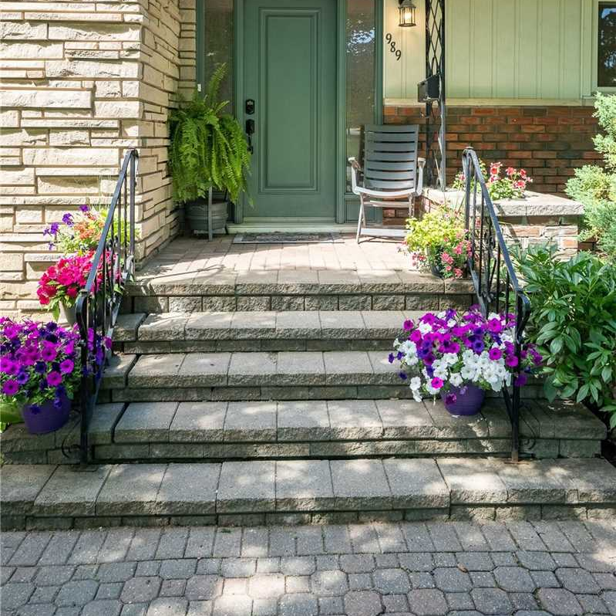
Micah House
Micah 6:8
“What does the Lord require of you? To act justly and to love mercy, and to walk humbly with our God.”

Slide 2
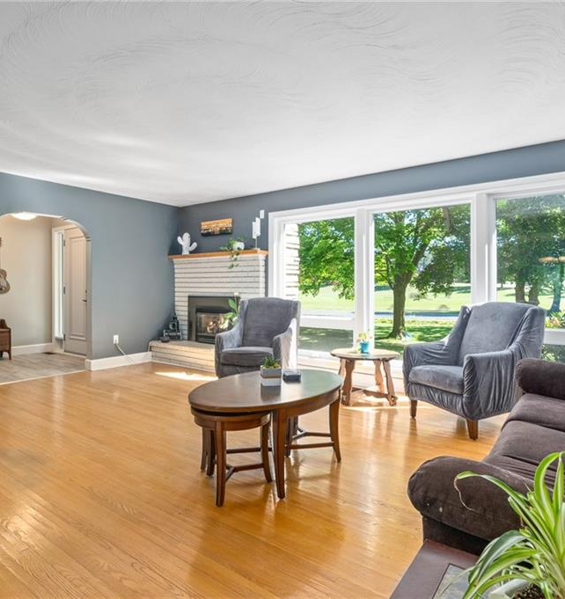
Welcome to Micah House
In association with Momentum Ministries serving as a missional house for students of Trent University

Slide 3
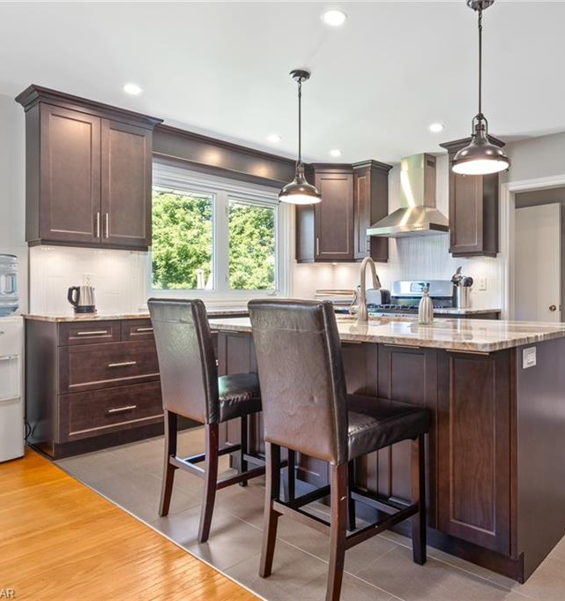
Micah House
Christian Community Living
Sharing meals and living space

